Slide 1
Y6 Robinwood Trip
Wednesday 11th June –
Friday 13th June 2025

Slide 2
Marchwiel near Wrexham
Approx 40 miles from Whitefield
1 hour 15 mins journey time
Coach travel

Slide 3
Staffing/supervision
45 children
Robinwood have one instructor for every 12 children
We will take 5 teachers/members of staff due to ratios
Children supervised at all times – members of Robinwood on duty all night
1 member of school staff on duty during night
Boys/girls dormitories

Slide 4
Key Themes
Challenge
Team Work
Perseverance
Support
Kindness
Encouragement
Friendship
Mentoring
Determination

Slide 5
Here is a sample
timetable of their
stay

Slide 7
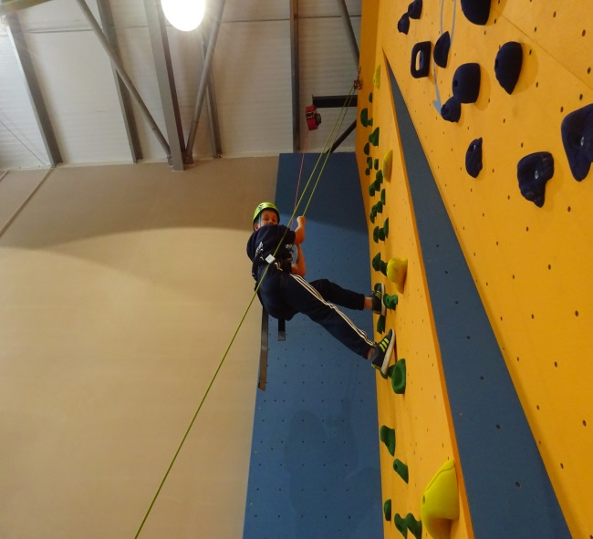
Clothing and Kit list
All specialist clothing is provided
-waterproofs, wellies, helmets etc.
Don’t pack anything nice or new!
Practical clothing – The children will get wet/dirty!
Kit List is available and will be sent out
No mobile phones, cameras or electronic devices please

Slide 8
Suggested Clothing List
There is no need to go out and buy anything special for a trip to Robinwood, all specialist equipment is provided .
The clothing list given includes clothing being worn on the journey, so for example, assuming you are wearing socks and underwear on your journey to Robinwood, you only need to pack 5 pairs of each!
3 T-shirts (not vest type)
3 Sweatshirts/(long sleeved) tops
3 Pairs of trousers
2 Pairs of shorts (mid thigh or longer for harness comfort)
6 Sets of underwear
6 Pairs of socks
1 Pair of trainers
1 Pair of outdoor shoes/boots
2 Towels
1 Coat (ideally waterproof
1 Warm hat/sun hat
1 Pair of gloves
1 Set of nightwear
1 Bag of toiletries (including suntan lotion/insect repellent in warm weather)
1 Black bin liner

Slide 9
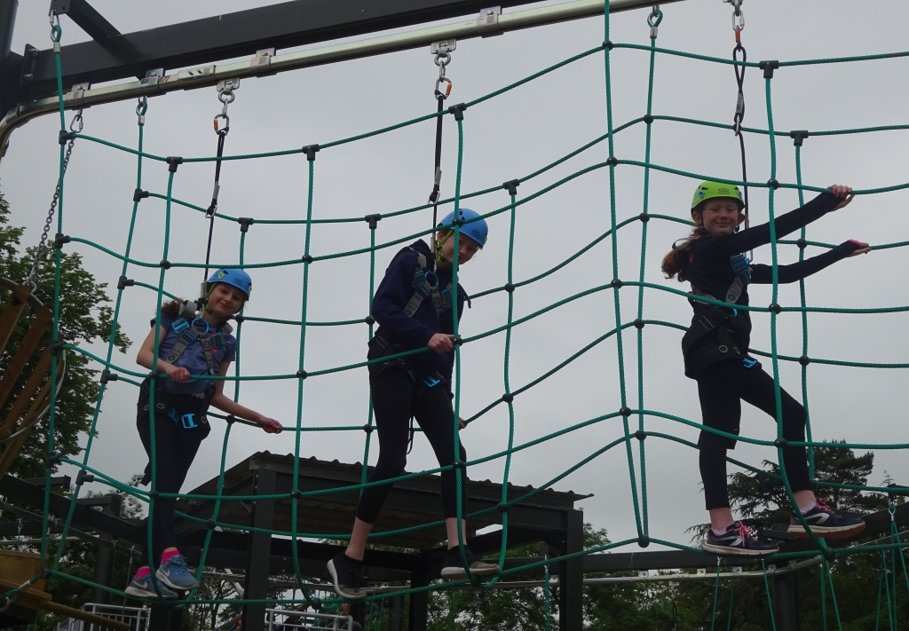
Personal Information Form
Dietary Requirements
Medical needs
Contact details
We will keep you
informed!

Slide 10
Payment Plan
The cost of the trip this year is £379.
The quality of the activities is outstanding.
The activities are back to back so the children get the most out of the day/night
The children are well fed (lots of treats too and healthy snacks) and the meals are excellent!
The safety of the children is a priority at all times
They will ALL have an amazing time!
We have broken the payment down if you wish to pay this way:
Deposit of £50 by 18th October
Followed by, 7 x payments of £47 running from November to May.
This is only a suggested payment plan and you can pay in full or alternative part payments.

Slide 11
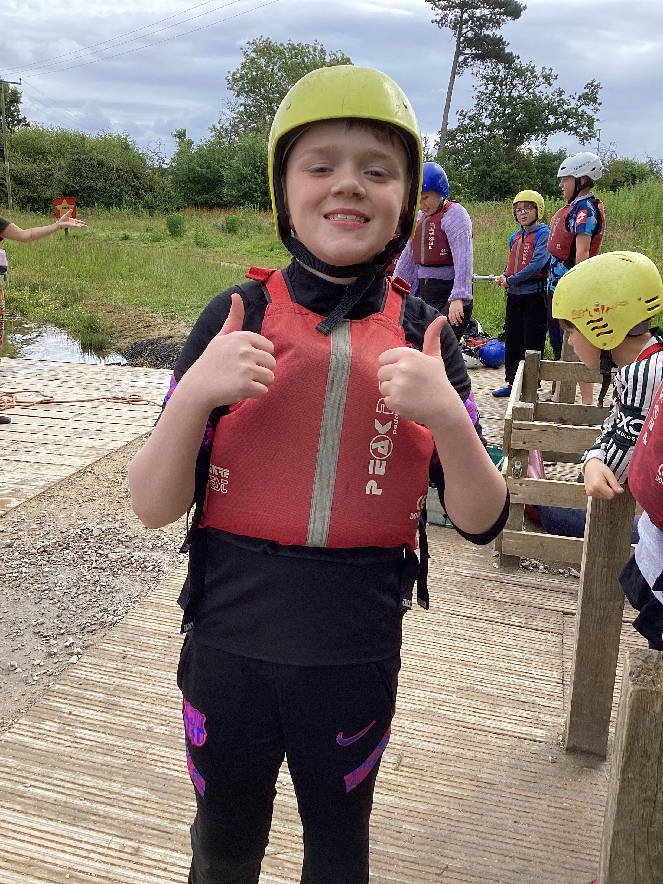
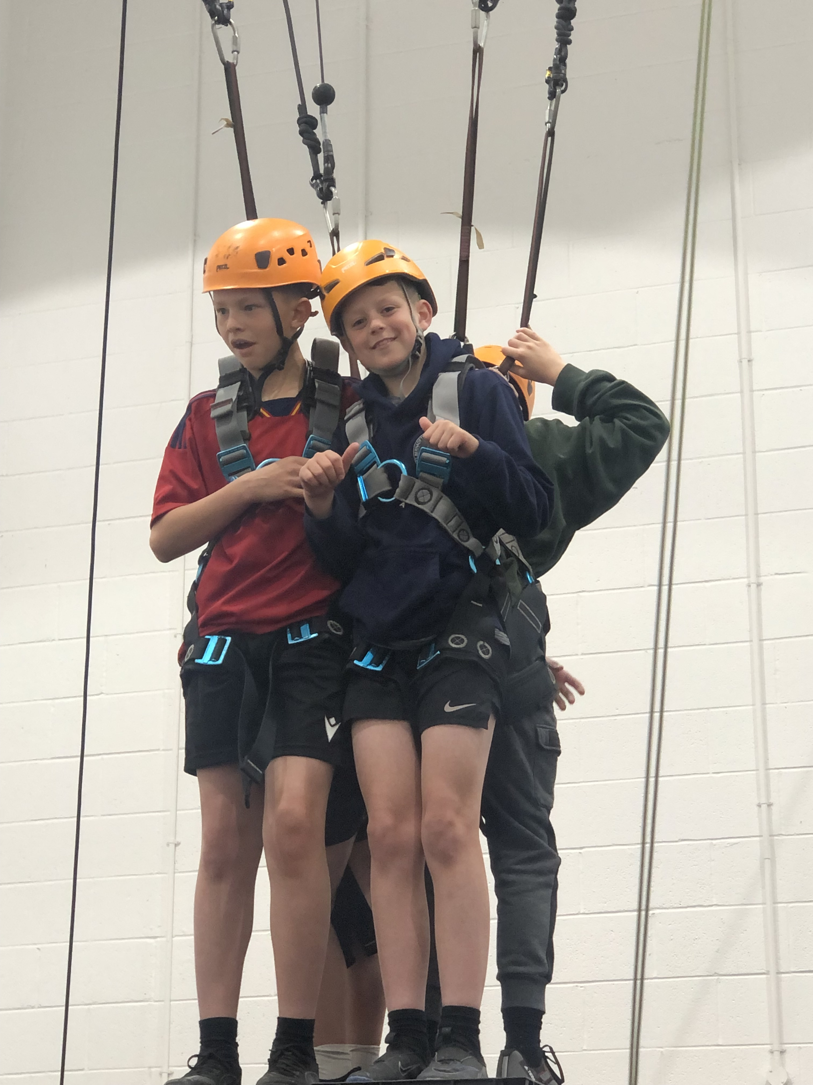

Slide 12
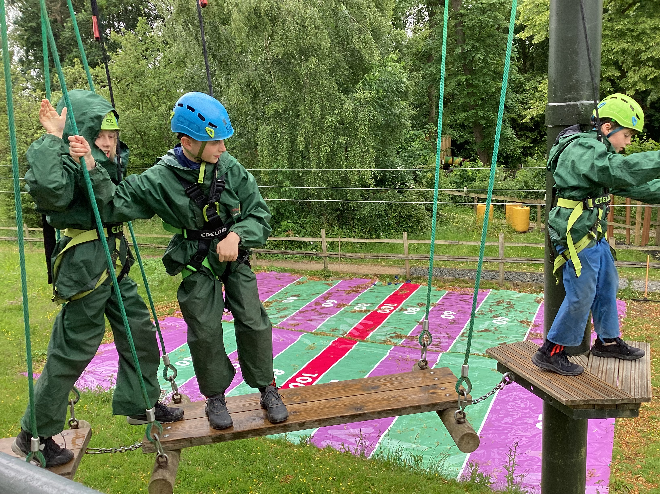

Slide 13
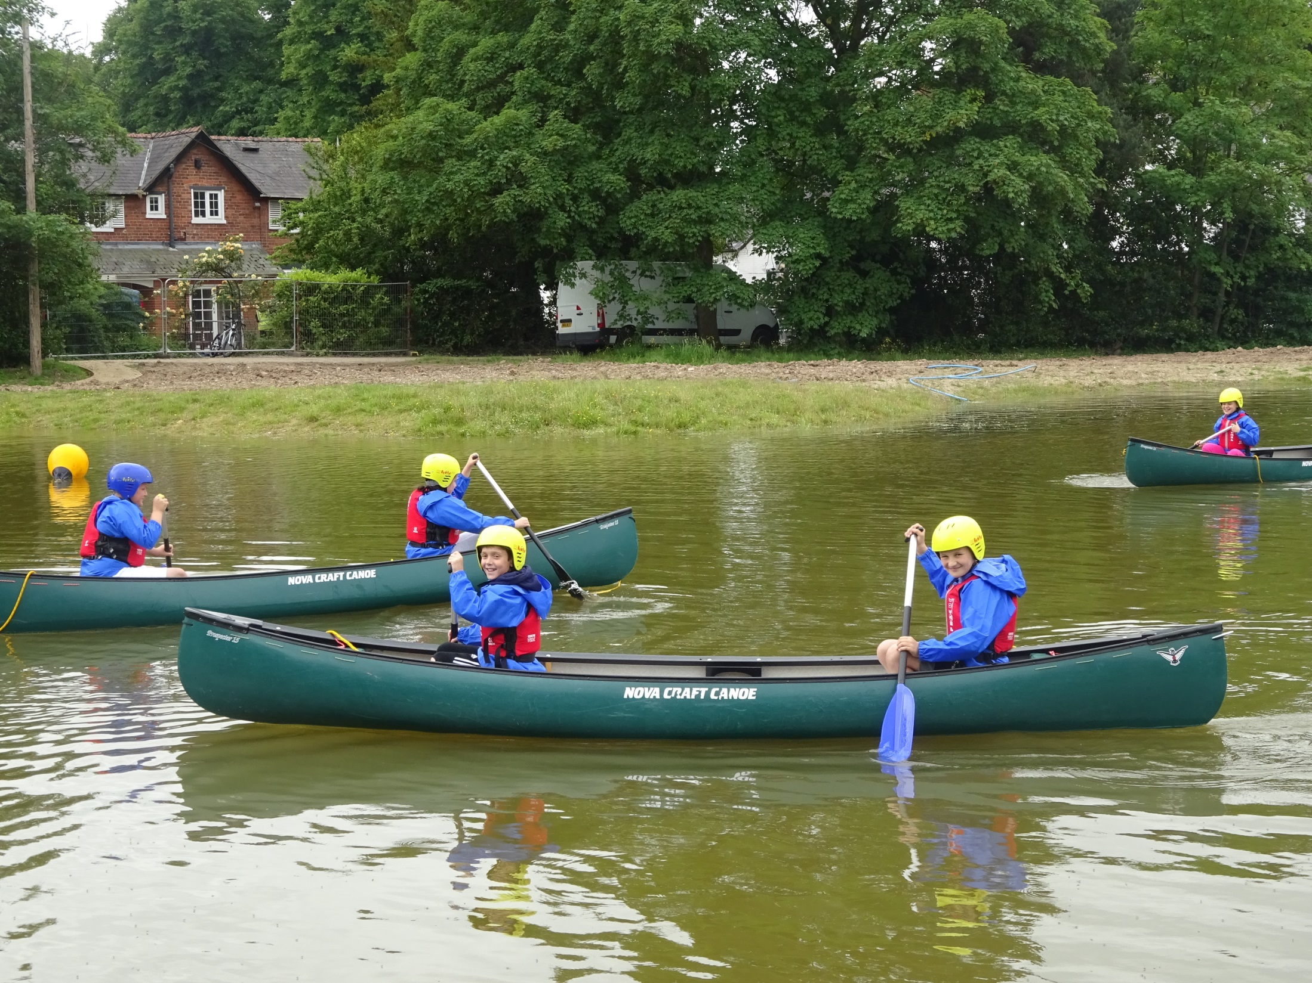

Slide 14
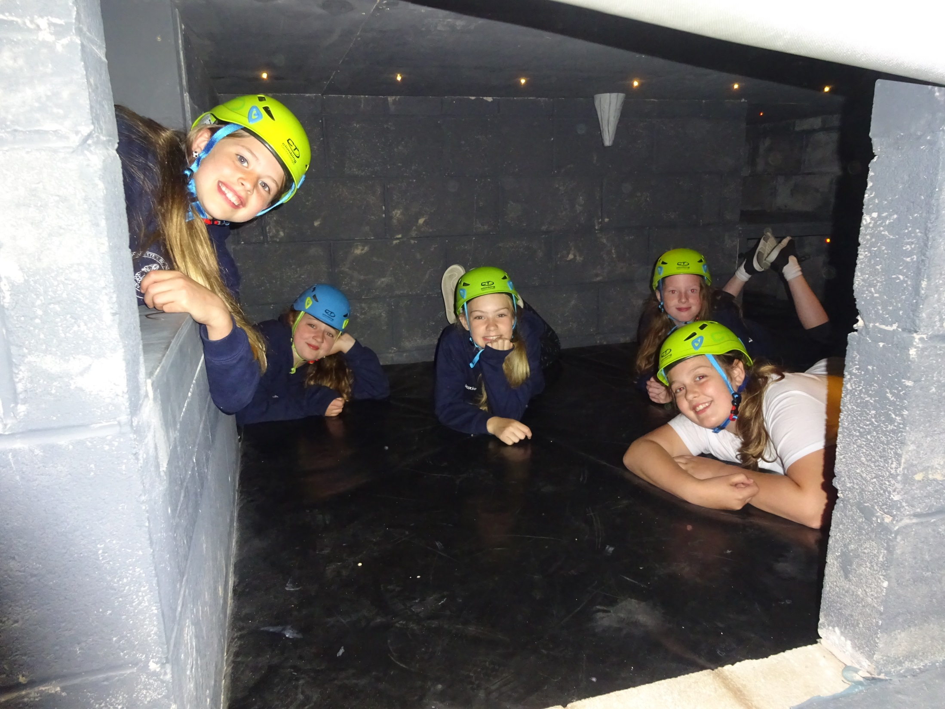

Slide 15
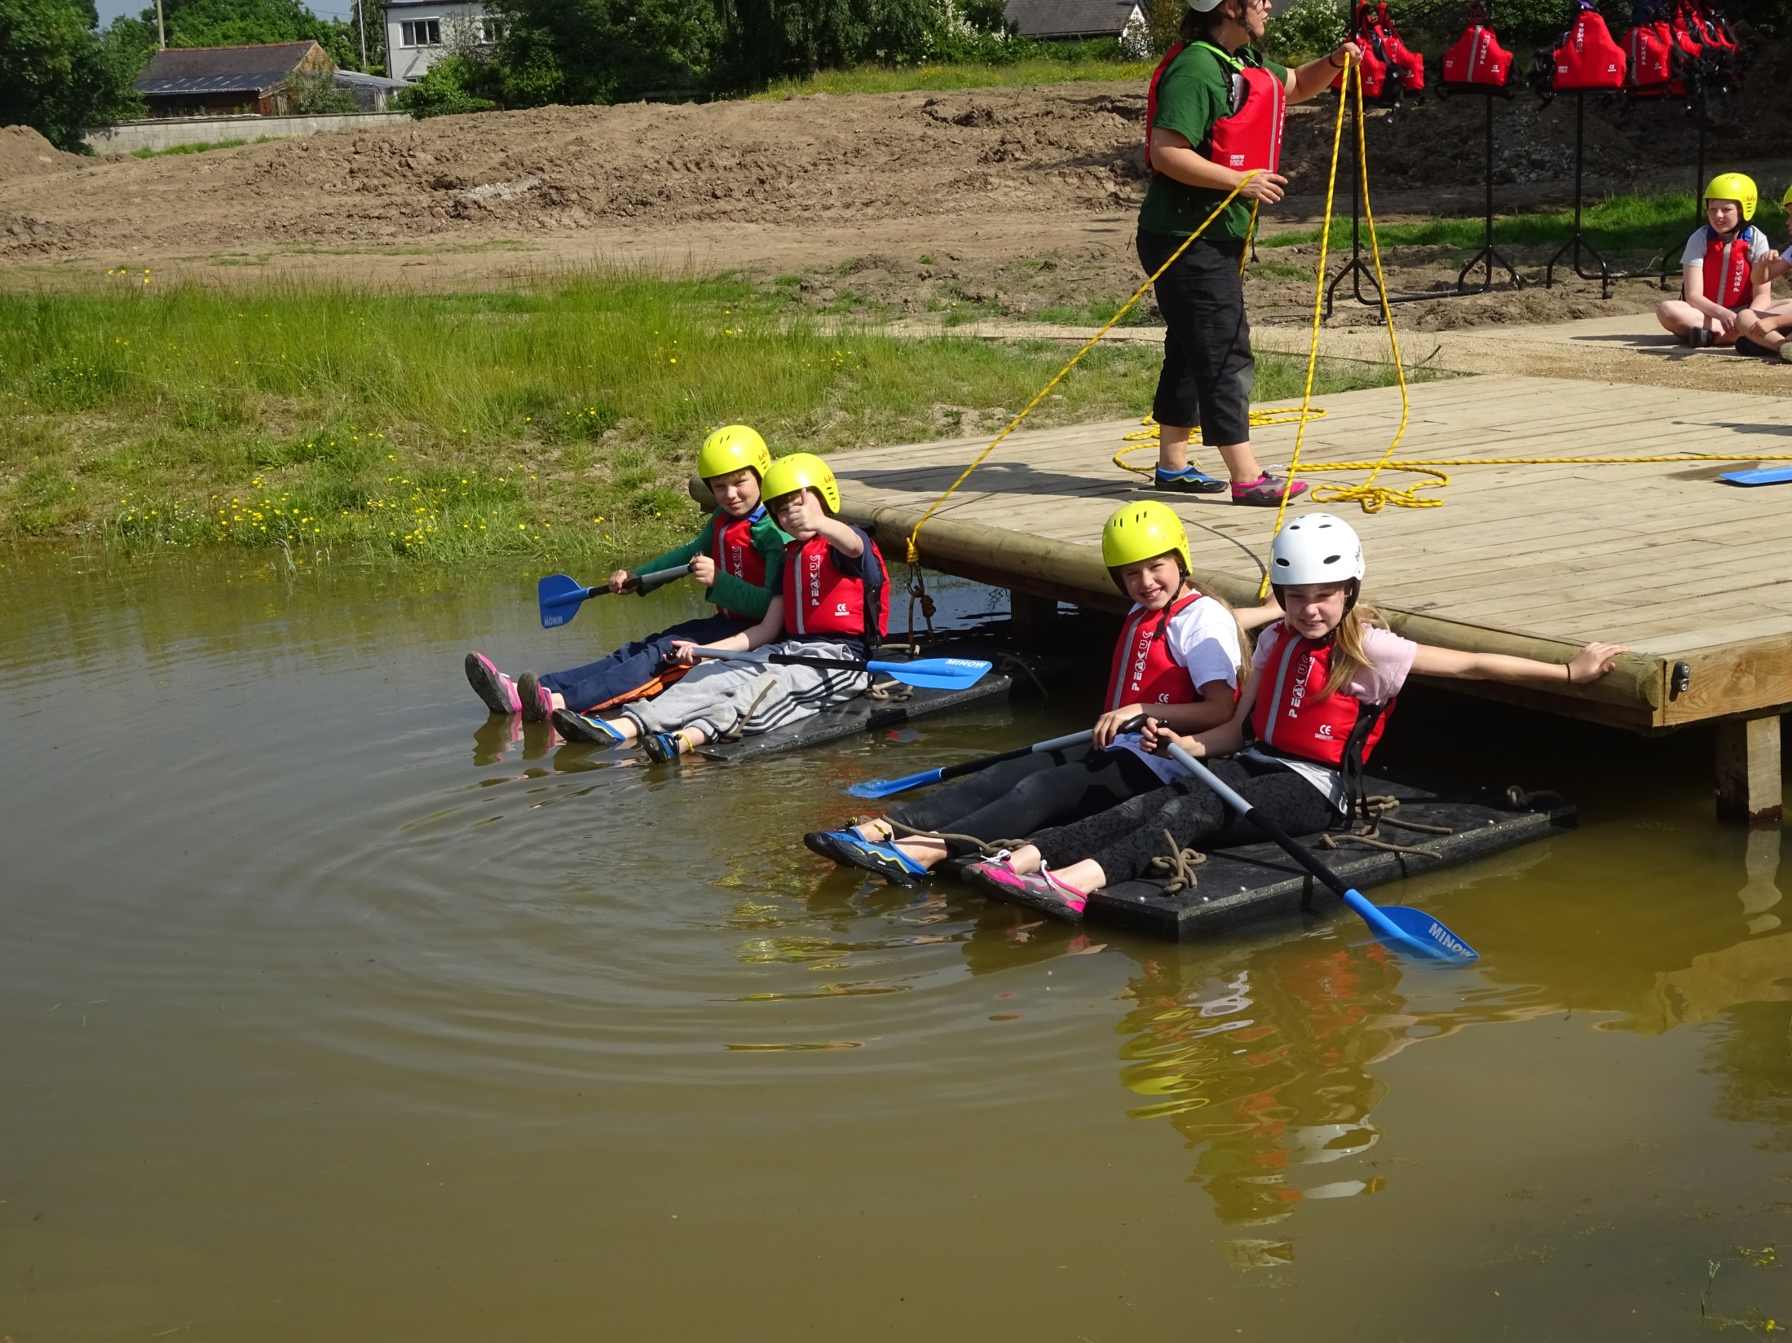

Slide 16
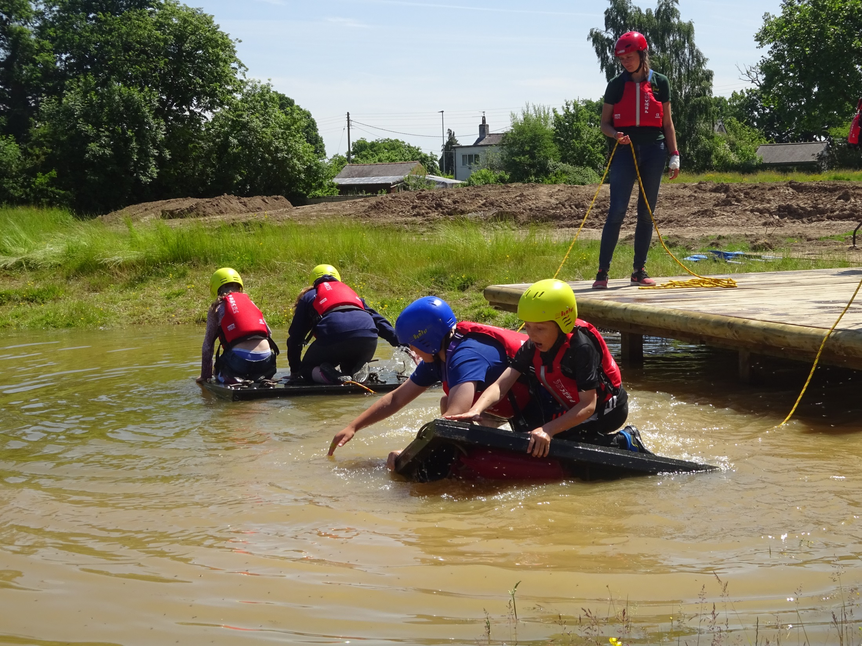

Slide 17
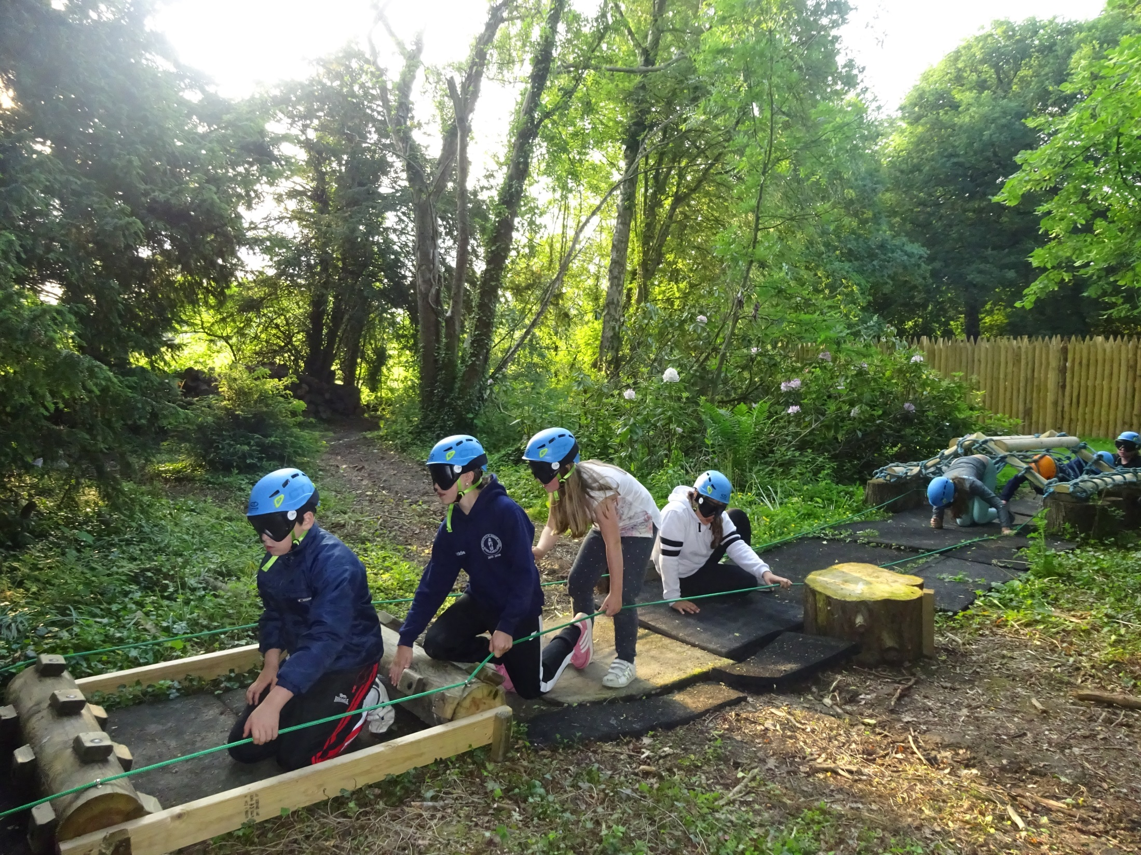

Slide 18
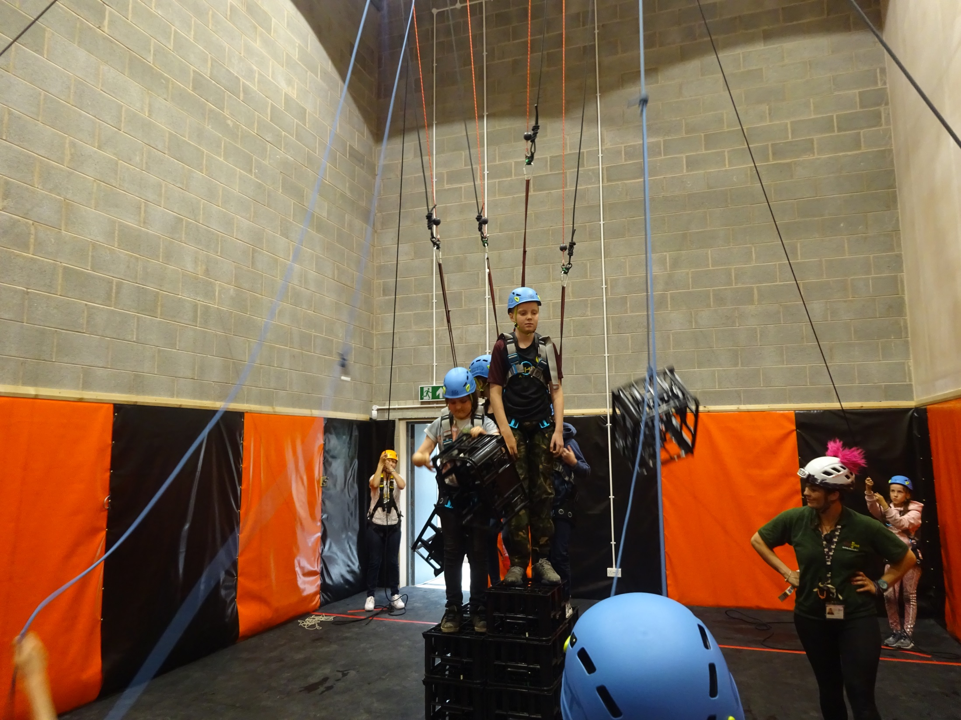

Slide 19
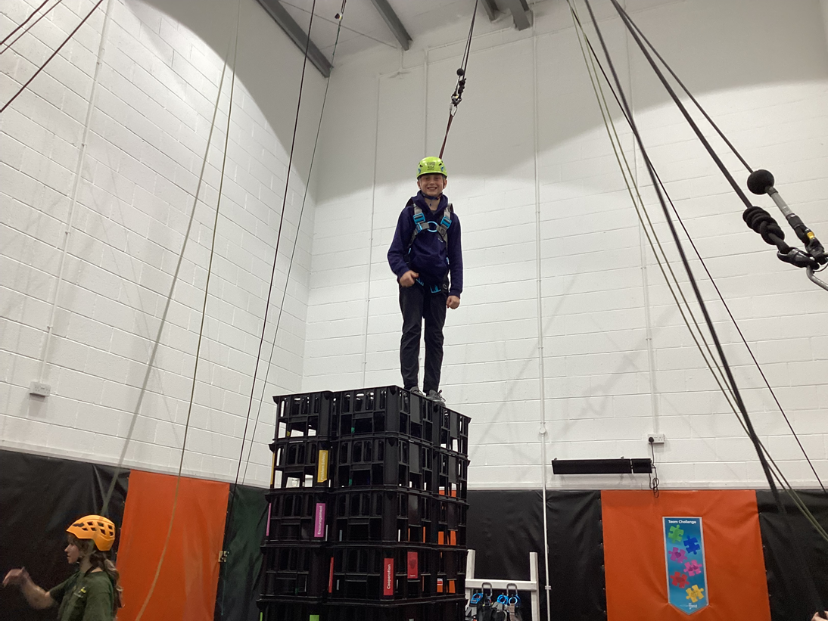

Slide 20
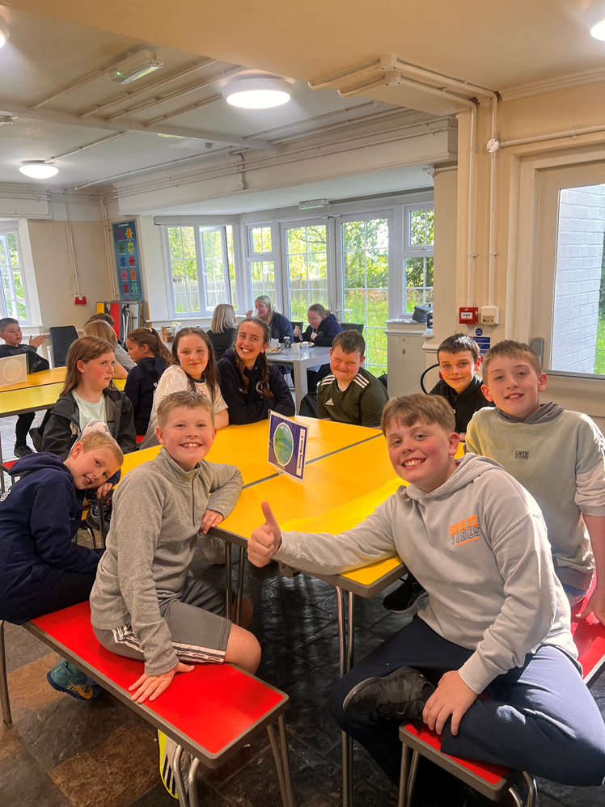

Slide 21
Website Details
https://www.robinwood.co.uk/ - general details about all Robinwood sites
https://www.robinwood.co.uk/activity_centers/cross-lanes/ - this is specific to the site that we are attending
https://www.robinwood.co.uk/activities/ - details of all the activities that the children will be doing at Robinwood.

