Slide 1
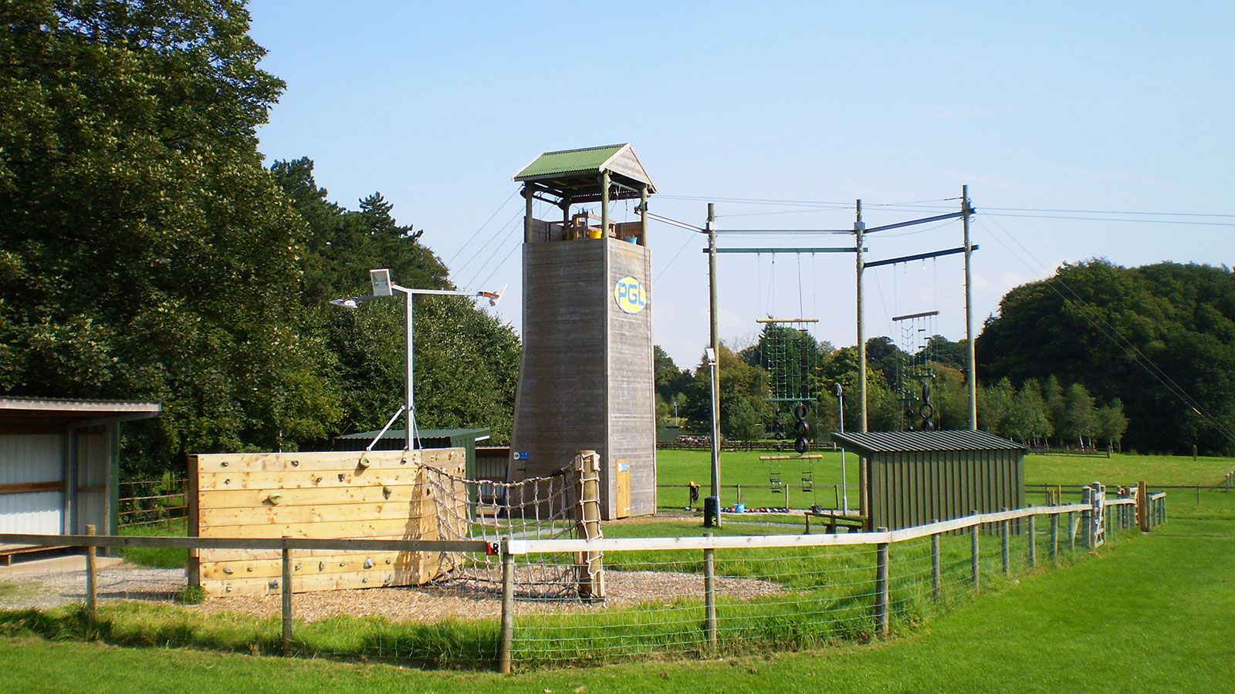
Year 5 PGL Trip
Thursday 1st May to
Friday 2nd May 2025

Slide 2
Winmarleigh near Garstang
50 miles
1 hour approx journey time
Coach travel

Slide 3
Our Booking Details
Payment Details
Total Price of £230
Deposit - £38
6 x monthly payments of £32

Slide 4
Staffing/supervision
44 children
PGL have one instructor for 12 children
We will take 5 teachers/members of staff
Children supervised at all times – members of PGL and our staff are on duty both night and day
Boys/girls dormitories and staff rooms are on the same corridor – we will be on hand for anything the children need

Slide 5
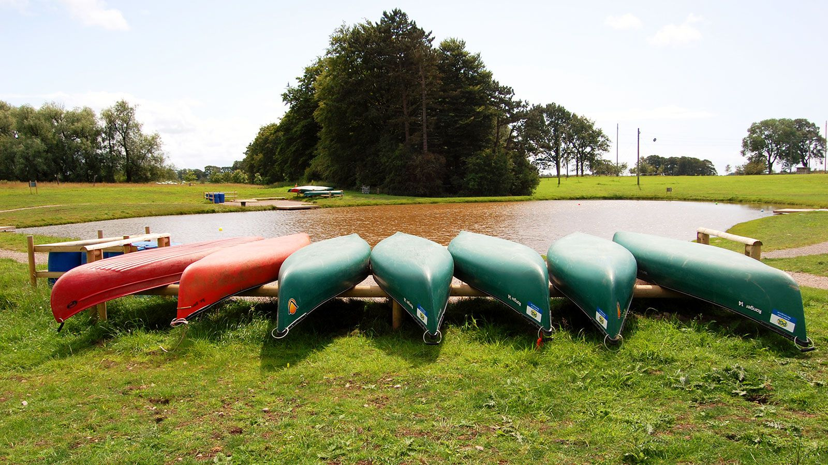
Challenge, Teamwork, Perseverance, Encouragement, Kindness and Support

Slide 6
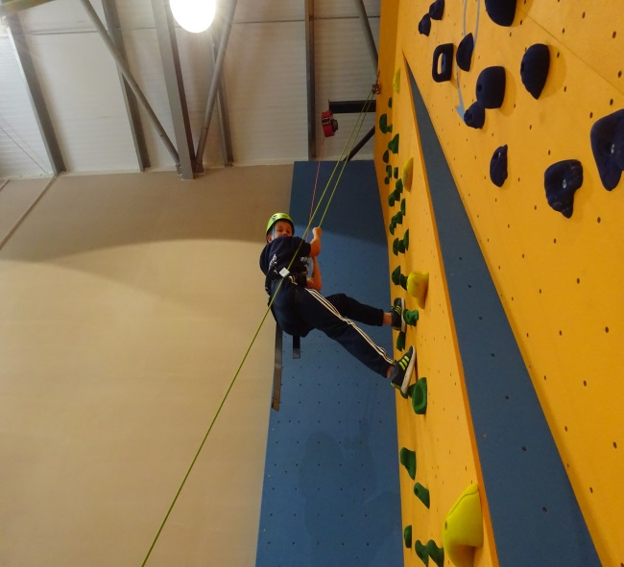
Clothing and Kit list
All specialist clothing is provided
-helmets, harnesses etc.
Don’t pack anything nice!
Practical clothing – The children will get wet/dirty!
Kit List – see next slide
No mobile phones, cameras or electronic devices please – we will be taking a camera from school and will Tweet regularly so you can see what they are doing.

Slide 7
Suggested Clothing List
There is no need to go out and buy anything special for a trip to PGL, but please label your child’s clothes!
The clothing list given includes clothing being worn on the journey, so for example, assuming you are wearing socks and underwear on your journey, you only need to pack 3 pairs of each!
3 T-shirts (not vest type)
3 Sweatshirts/(long sleeved) tops
3 Pairs of trousers
2 Pairs of shorts (mid thigh or longer for harness comfort)
4 Sets of underwear
4 Pairs of socks
2 Pairs of trainers (one for dry activities / one for wet activities)
1 Pair of outdoor shoes/boots
2 Towels
1 Coat (ideally waterproof)
1 Warm hat/sun hat
1 Pair of gloves
1 Set of nightwear
1 Bag of toiletries (including suntan lotion/insect repellent in warm weather)
1 Black bin liner
1 x Sleeping Bag or Duvet
1 x Pillow

Slide 8
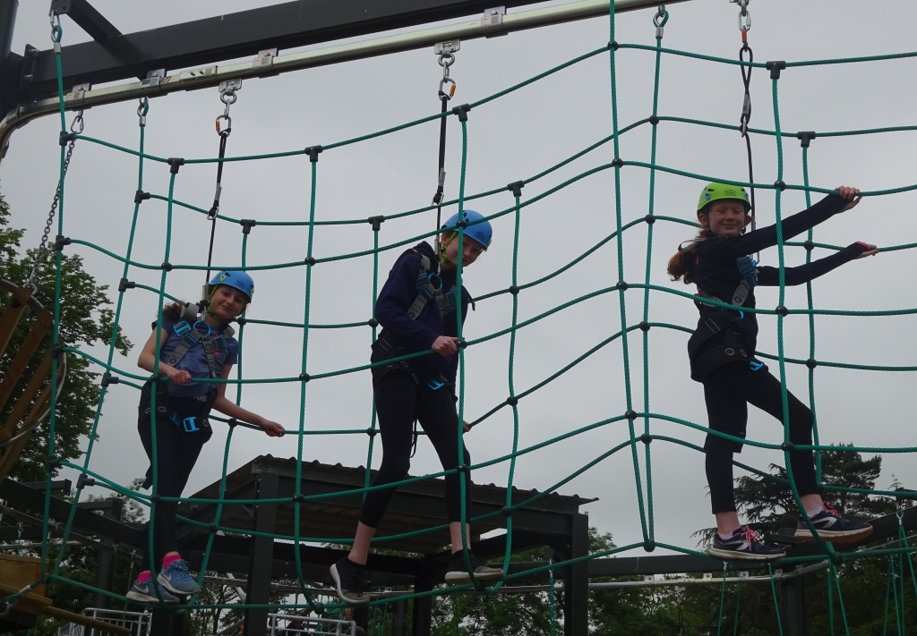
Personal Information Form
Dietary Requirements
Medical needs
Contact details
Payment plan
Pocket Money - £5 gift shop
We will keep you informed!

Slide 10
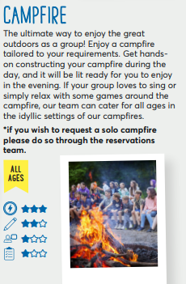
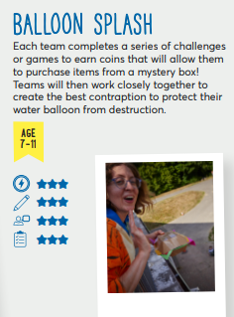
Evening Activities

Slide 11
Website Details
https://www.pgl.co.uk/en-gb/school-trips/primary-schools/centres/winmarleigh-hall

