Slide 1

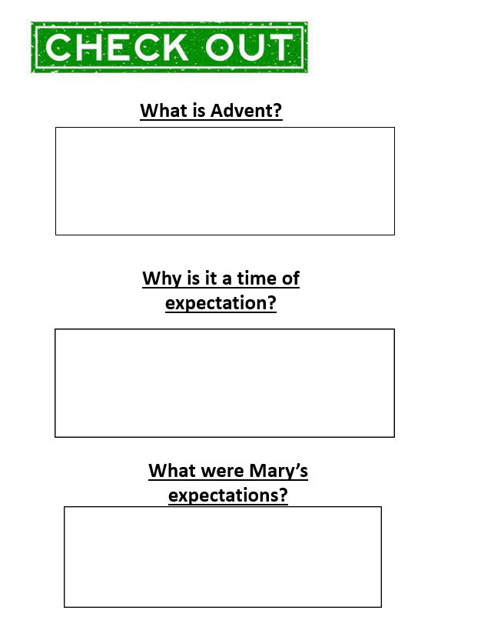

What is Advent?
Why is it a time of expectation?
What were Mary’s expectations?

