Slide 1
Meet the Teacher Mrs O’Donnell
Year 3/4 2023-24

Slide 2
Morning routine
Start the day with prayers and morning challenge
Register at 8:55am
English – Monday to Thursday
Grammar and handwriting practise included into English
Lessons
Friday – may be stand alone Grammar lessons if needed
Break at 10:25am.

Slide 3
Afternoon routine
Lunch at 12:05 – 1.15pm.
Geography, History, Computing, PE – weekly
Guided Reading and DEAR – most afternoons
Collective Worship – Wednesday
R.E. will be taught following our Come and See scheme - 10 % teaching time

Slide 4
Year 3 and 4 - Topics
Please have a look at the newsletter for all our lesson topics (email)
English: The Stone Age Boy
Maths: Number, place value, multiplication, addition and subtraction skills
Times tables – continual focus
RE: Homes, Promises and Visitors
Science: Forces and Electricity
History/Geography: The Stone Age / Weather and Climate
Topics rotate over a 2 year cycle – Year A & B

Slide 5
Maths - Calculation policy
Here is our calculation policy for Year 3 and 4 so that you can support your child’s learning at home!

Slide 6
Addition of 3-digit numbers

Slide 7
Addition of 4-digit numbers

Slide 8
Important skills:
Line up numbers correctly (Th H T O place)
Always start with the ones
Regroup if more than 9
Remember to rename and move the regrouped ten
Put the renamed one under the line (place value)
Remember to add the small one to the other digits

Slide 9
Addition with decimals

Slide 10
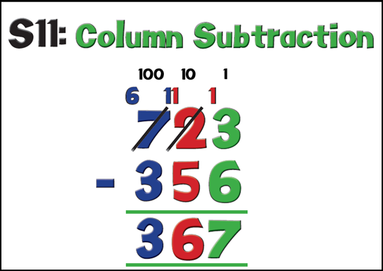
Subtraction of 3-digit numbers

Slide 11
Subtraction of 4-digit numbers

Slide 12
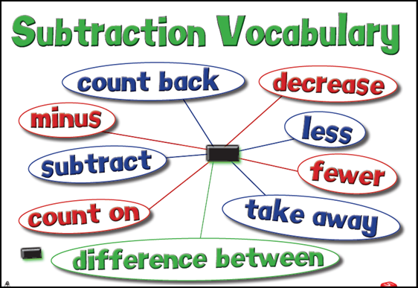
Important skills:
Always write the biggest number first
Line up numbers correctly (THTO place)
Always start with the ones
Exchange ten from the left if top number is smaller
Remember to cross out and rename the digit on the left

Slide 13
Using the Grid Method
(TO x O)

Slide 14
Using the Grid Method
(HTO x O)

Slide 15
Important skills:
Partition the number into hundreds, tens and ones
The multiplier always goes on the left
Write down each total and then add them together.

Slide 16
Short Division (without remainders)
Dividing 3-digits by a single digit

Slide 17
Short Division (with remainders)
Dividing 2-digits by a single digit

Slide 18
Important skills:
Known as bus stop division
The divisor always goes on the left
Always start with the biggest value
Times tables knowledge
Write down the amount remaining.

Slide 19
Things to remember…
PE for Year 3/4 will take place on a Tuesday afternoon. In Autumn 2, it will take place on a Tuesday and Thursday afternoon.
Please ensure that children have a full, correct PE kit and suitable footwear on these days.
Spelling tests/times tables test are on a Friday.

Slide 20
Homework
Homework will include:
A paper copy of the weekly spellings to practise and learn.
MyMaths assignments – logins are in the journals
Handwriting practice – a handwriting to sheet to cover some of the week’s learning.

Slide 21
Reading / Journals
Please ensure children are reading daily for at least 15 minutes.
Children will be sent home with 2 paper books
Please also ensure journals are signed as they will be checked daily – rewards given
Any communication can be written in journals – please let the children know too if you can ☺

Slide 22
Rewards
Table Points
House points
Raffle Tickets
Comfy cushions

Slide 23
Sacramental Programme - Y3 Children First Reconciliation - during Lent time Holy Communion - May/June Dates and more information coming soon…

Slide 24
Multiplication Tables Check (MTC)
Year 4 Children
Beginning of June – 3 week period
This is to identify pupils who have not yet mastered their times tables - additional support can be provided.
The children will be given 25 questions and they need to answer them in 6 seconds.
We do a lot of work on them up to the point of the check
Knowing timestables will make maths in Year 4 easier and help you to be ready for Year 5 next year.
Please support and practise at home - thank you!

Slide 25
And finally…
Parent helpers are always much appreciated ☺
Collection from classroom at the end of the day
School website / Twitter
http://www.stbernadettesrcprimary.org.uk/
@stbernadettesrcp
Class Stay and Pray – Wednesday 8th November 2023 2:45pm ‘Remembrance’

Slide 26
Useful Websites
Top Marks
Times Tables Rockstars
Maths Zone
BBC Bitesize (7-11)
Any Questions?
Thank you for coming!

