Slide 1
Meet the Teacher
Miss Owens

Slide 2
Staff in our classroom are
Mrs Boon
Mrs Cullen
Mrs Cain – Thursday Afternoon

Slide 3
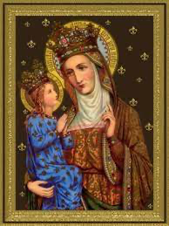
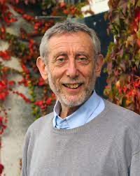
Class Saint
Class Author
Saint Anne
Michael Rosen

Slide 4
Phonics
Your child will continue to use phonics to read and spell new words.
High quality daily phonics sessions will allow children to write accurately, fluently and with automaticity.
Website contains all essential information and newsletters.

Slide 5
Spellings
Research shows that the traditional spelling test is one of short-term memory and does not support children in understanding the principles of spelling.
Stressful and unnecessary pressure on both children and parents.
Phonics lessons informally assess through daily practice of spellings linked to the phonics focus.
More time to informally assess on a Friday with the use of ‘tricky tess’ time.

Slide 6
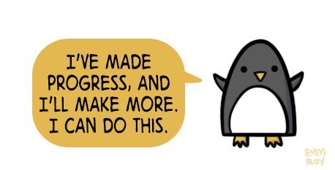
Y2 SATS
DfE has made the decision that Year 2 SATS are now non-statutory and optional.
Children are assessed when they enter reception through a baseline assessment which is now statutory.
Teachers will use NFER assessments to support teacher judgement as well as the use of past SATS papers in an informal way.

Slide 7
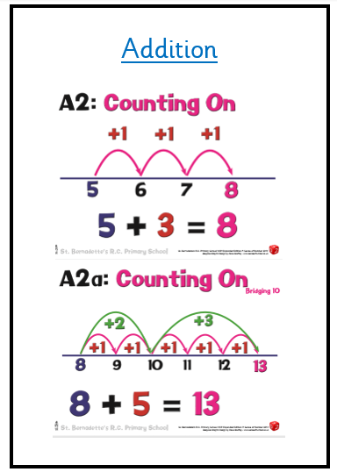
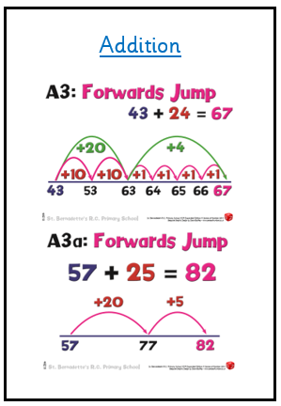
Addition
Subtraction

Slide 8
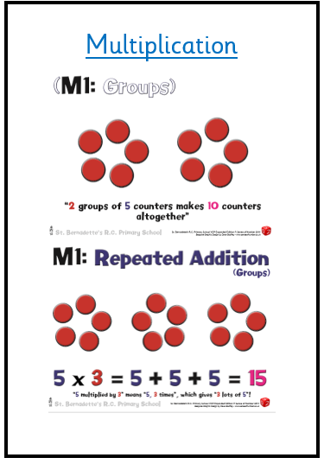
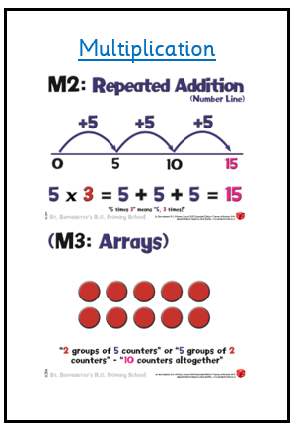
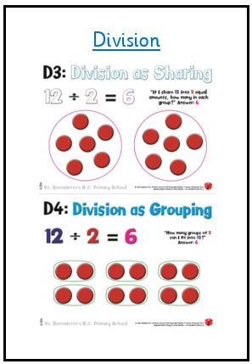
Multiplication
Division

Slide 9
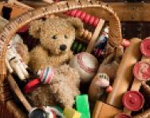
Topics
Our Geography-based topic is about Manchester.
We will think about the human and physical features found in Manchester and our local area using maps, atlases and field work.
Our History-focused topic is all about Toys.
We will explore what toys were like in the past and will know how they are different from today. We will play with toys, old and new.

Slide 10
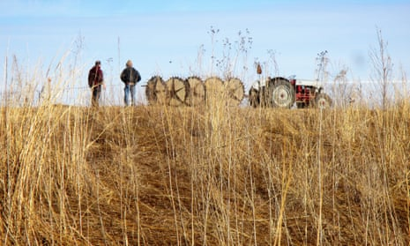
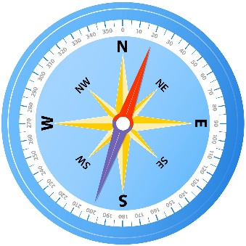
Spring Term Topics:
Why is Britain great?
How do farms help us?
Summer Term Topics:
Compass Points!
If you have any resources/ know anyone with links to our topics, please let me know so we can make them as exciting as possible!
All information about topics, will be sent in the letters at the start of each new term (and can be found on the website)

Slide 11
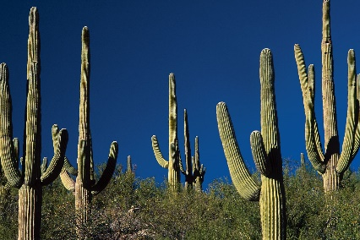
Science
We will learn about Animals including Humans, Materials and Living Things and their Habitats through our first topic, ‘What’s Wrong with Mr Bear?’ which is linked to our work on Peace at Last.
After half term, we will explore, Animals including Humans and Living Things and their Habitats through our topic, ‘Would you see a Cactus in a Rainforest?

Slide 12
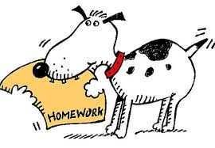
Homework
Maths consolidation or pre-teaching via MyMaths.
Set each Friday, to be completed by the following Friday.
Any issues, please communicate via your child’s journal or I am available on the door in the morning.

Slide 13
Reading
2 paper books
Please sign the journal
Send in journal every day
Listen to your child read
Can they recall what they have read? (Retrieval)
Find and recall the meaning of words? (Vocabulary)
Can they make predictions? (Prediction)
Books are changed once a week – Wednesday

Slide 14
How you can help at home
Promote independence – looking after belongings, getting dressed.
Reading – before bed, before school, straight after school (create reading time).
Telling the time! (o’clock, half-past, quarter-to and quarter—past) This is a tricky concept and a head start will benefit your child.

Slide 15
Final Messages
PE – Monday and Thursday. Please ensure full kit and sensible shoes are worn.
Earrings – please don’t wear on PE days.
Water bottles – please send in full. Plain water only.
Any messages in journal – these are checked daily.
Please check X and our class page on the website. If any children are NOT allowed their photograph online please remind me at the end.
Sign the contract covers in the journal if you haven't already.
Stay and Pray 22.05.24 (Month of Mary).

Slide 16
CAN YOU HELP?
We would love any family members (including yourselves) to read to the class during our DEAR time!
Please let me know or write in your child’s journal and we can arrange a date and time! ☺

